Slide 1
“We are the pioneers of the world; the advanced guard sent through
the wilderness of the untried things to break a new path in the New
World that is ours.” (Herman Melville, 1852)

Slide 2
Is rapid urbanization a global concern?
By: Whitney Roesicke

Slide 3
Is rapid urbanization a global concern?
Immigration
Should immigration be restricted in order to reduce urbanization?

Slide 4
Thesis
Overpopulation
Threatens national security
Counter-thesis
Increases businesses
&
Adds more jobs

Slide 5
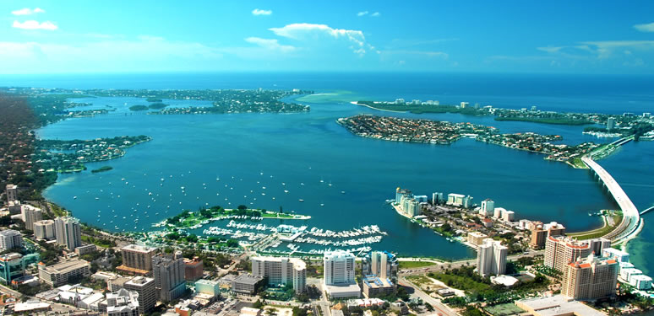
Sarasota
(Lazaro, 2011)

Slide 6
Thesis

Slide 7
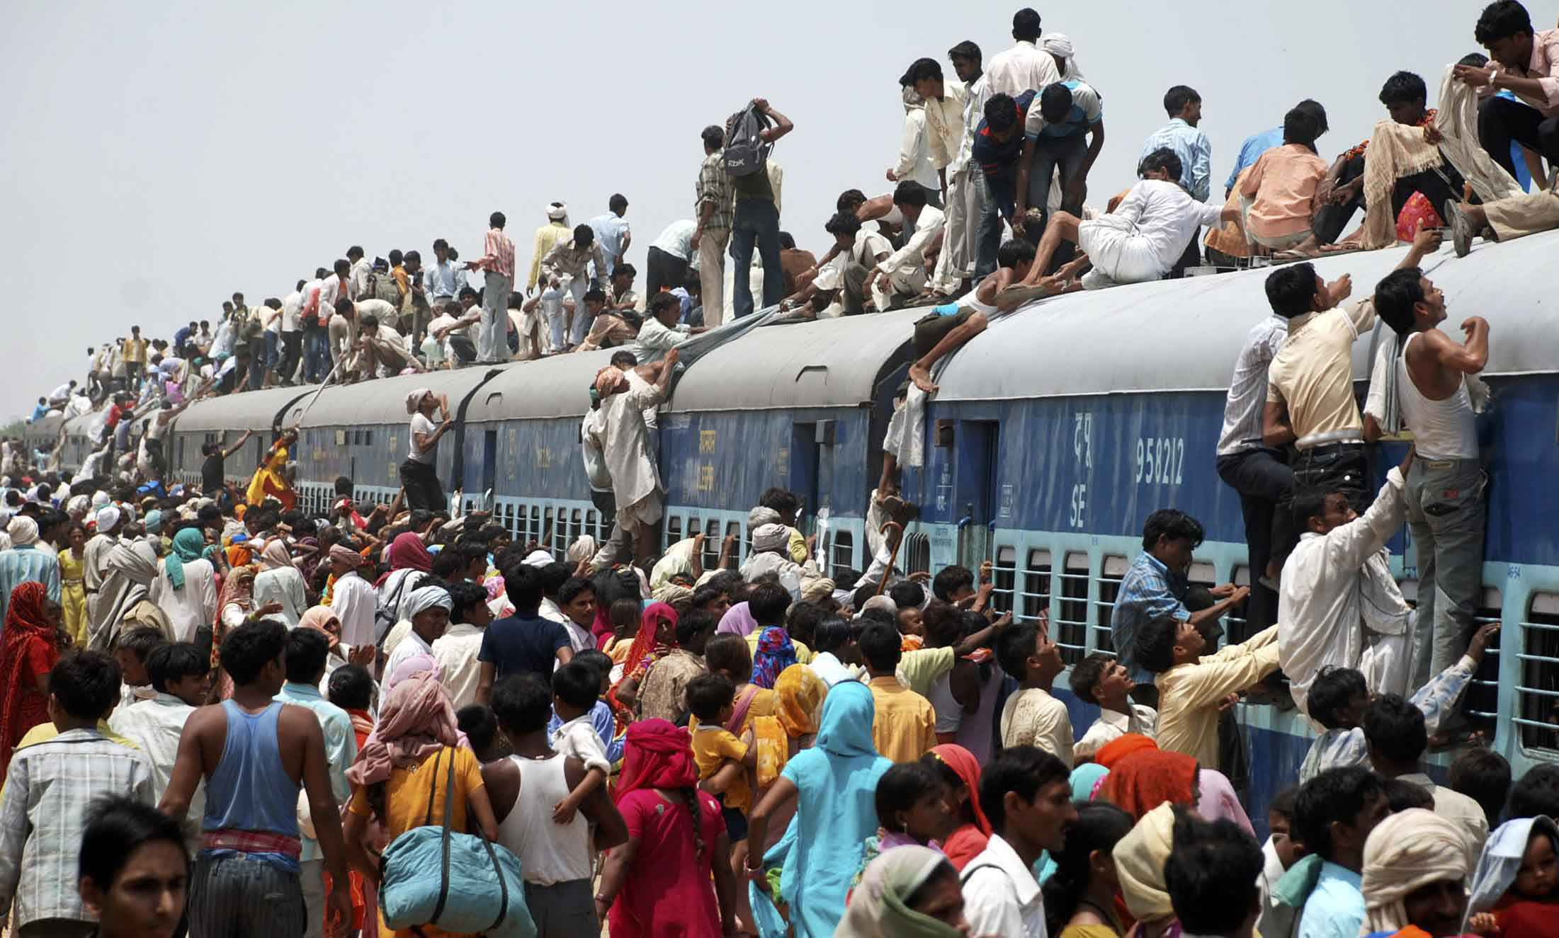
Overpopulation
“At roughly 1.2 billion inhabitants, India’s population is projected to grow to 1.8 billion before stabilizing around the middle of this century. It is already six times Brazil’s current 200 million, a figure that is stable and likely to begin descending in years ahead. Not surprisingly, Brazil’s per capita GDP is more than three times that of India.”(Lazaro, 2011)
(Browning, 2012)

Slide 8
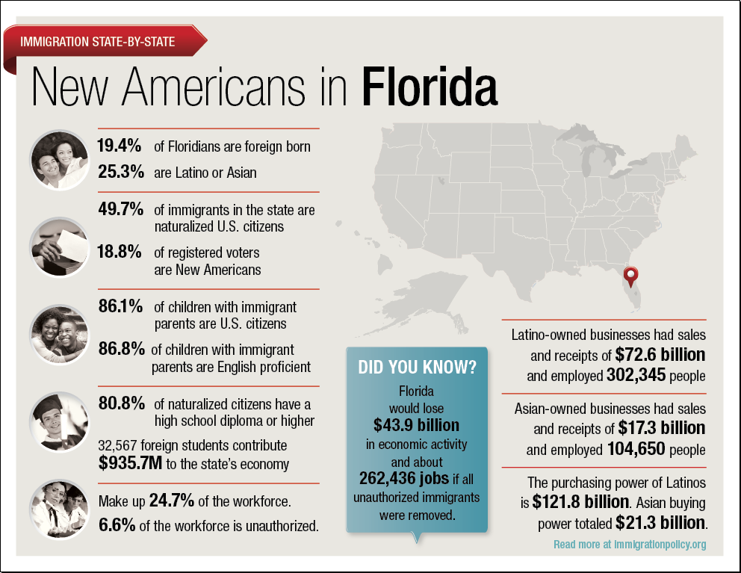
Overpopulation
“It is estimated that Florida adds 650 new residents every day, a million every four years. Even at 1992 growth rates, each day we needed two new miles of roads, two new classrooms, two new teachers, two new police officers, one more jail cell and two more prison beds, according to a state-sponsored study. At current growth rates, each day we need 111,000 more gallons of fresh water than we did the day before. Each day we flush 95,000 more gallons of waste water and generate 3,500 more pounds of solid waste.”(Browning, 1999)
(Nielson, 2009)

Slide 9
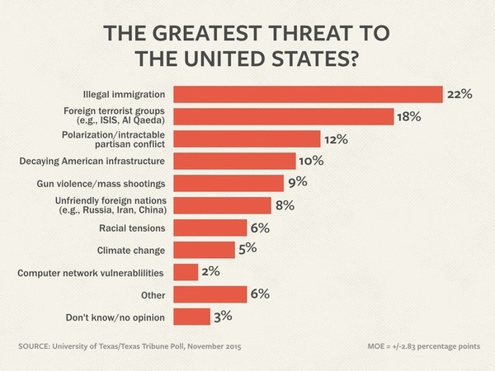
Threatens national security
“It is immigration in general, whether voluntary or involuntary, legal or illegal, that constitutes this threat, as long as the immigrants pose a challenge to the identity of the receiving state through their different language, culture, or religion.”(Tallmeister, 2013)
(Tallmeister, 2013)

Slide 10
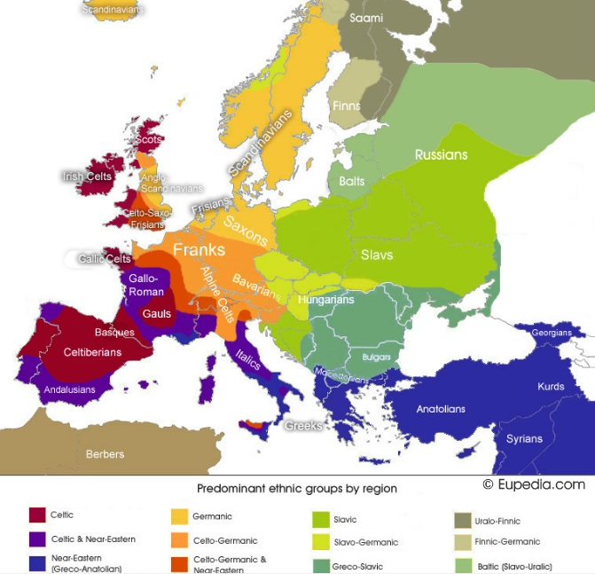
Threatens national security
“Most European states have undergone a transformation from fairly homogeneous states, whose members have been generally bound by a common sense of cultural and ethnic identity, to heterogeneous states made up of several national groups. In these cases, immigration may be seen as a societal security threat as it challenges a state’s traditional national identity and core values.”(Tallmeister, 2013)
(Tallmeister, 2013)

Slide 11
Counter-thesis

Slide 12
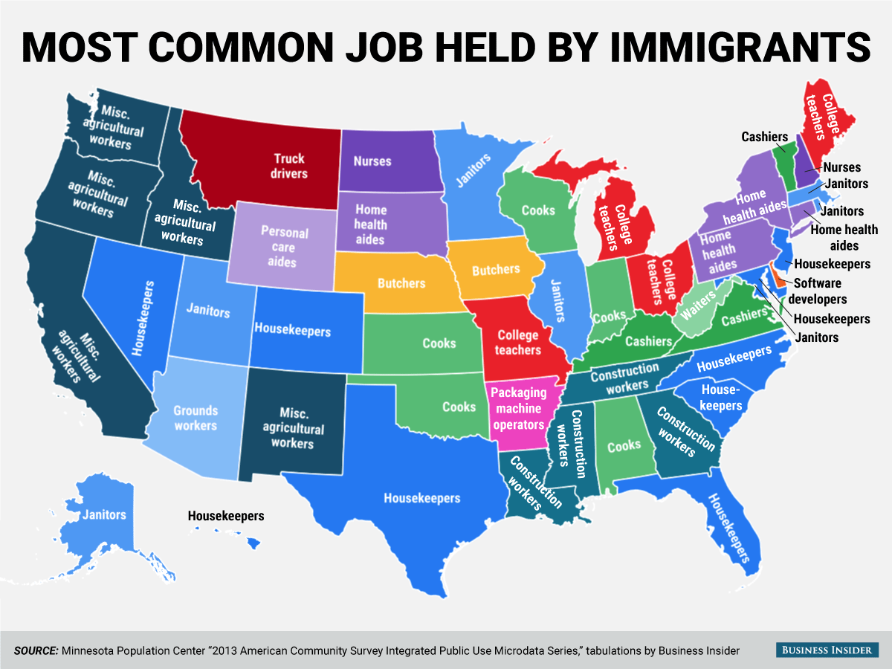
Improves businesses and adds more jobs.
“Sweden has identified 1,700 teachers among its newly arrived refugees. They will be put on a fast-track program from January, preparing them to work in schools—especially ones in which refugee children are swelling classes.”(Getting the new arrivals to work, 2015)
(Lazarro, 2011)

Slide 13
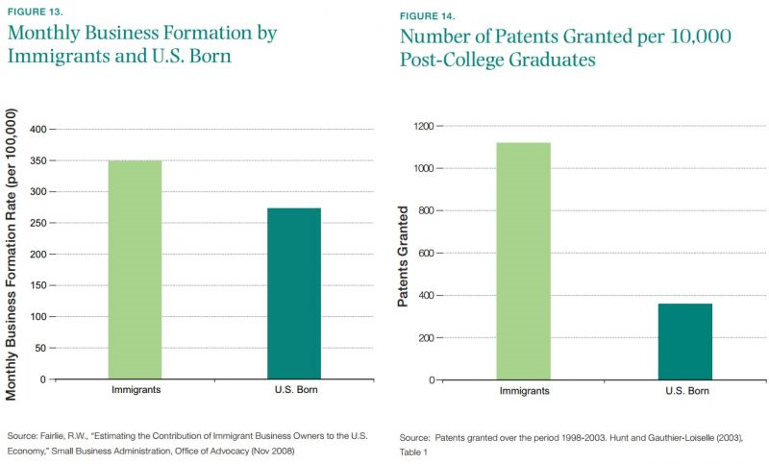
Improves businesses and adds more jobs.
“Immigration could also improve Europe’s economic performance over the medium-to-long-term in a number of ways. Immigrants bring different skills and aptitudes and can transmit those to non-immigrant colleagues (and vice versa). They can increase competition in particular labor markets, increasing the incentive for natives to acquire certain skills. Indeed, evidence from Denmark suggests a refugee influx in the late 1980s had just this impact. And workplace diversity can boost productivity.”(Portes, 2015)
(Lazzaro, 2011)

Slide 14
References
- Browning, M. (1999, October 20). News Articles - NPG Florida Opinion Poll on Overpopulation
and Sprawl. Retrieved from http://www.npg.org/projects/flpoll/fl_poll_clips.htm
Getting the new arrivals to work. (2015, December 12). Getting the new arrivals to work | The
Economist. Retrieved from http://www.economist.com/news/business/21679791- businesses-could-benefit-and-refugees-integrate-faster-if-newcomers-europe-were- able
Lazaro, F. (2011, October 19). India's Growth Held Back by Overpopulation | PBS NewsHour.
Retrieved from http://www.pbs.org/newshour/updates/globalhealth-july-dec11- population_1019/
Melville, H. (2015, April 21). White Jacket by Herman Melville: Chapter 36. Retrieved from
http://www.online-literature.com/melville/white-jacket/36/
Nielsen, G. (2009). How is the government dealing with illegal immigration? Retrieved from http://immigrationquality.blogspot.com/
Portes, J. (2015, September 15). Immigration Is Good for Economic
Growth. If Europe Gets It Right,Refugees Can Be Too. Retrieved from http://www.huffingtonpost.com/jonathan- portes/economic-europe-refugees_b_8128288.html
Tallmeister, J. (2013, August 24). Is Immigration a Threat to
Security? Retrieved from http://www.e- ir.info/2013/08/24/is-immigration-a-threat-to-security/
Urbanization and Global Change. (2006, January 4). Urbanization
and Global Change. Retrieved from http://www.globalchange.umich.edu/globalchange2/cur rent/lectures/urban_gc/

